Slide 1
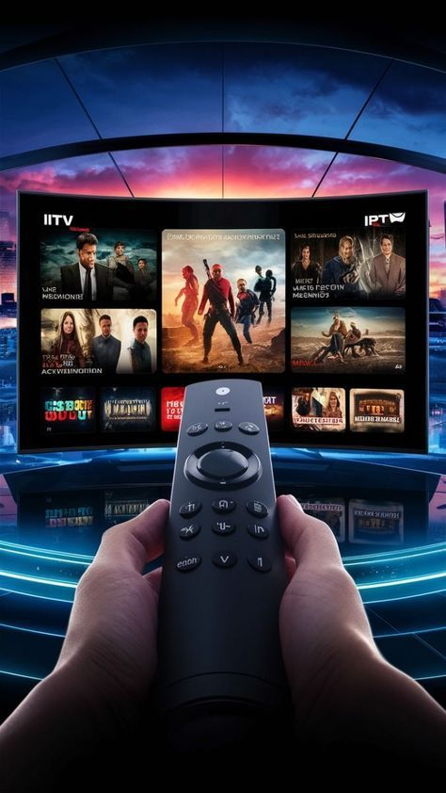
Bright TV Analysis
BY Nothando Mkhomazi

Slide 2
Top channels
The top channels chart shows a clear concentration of viewership around a small group of channels.
This indicates content driven loyalty with users returning to very specific content genres.
The channels with the lowest view are Wimbledon and live on Sport. Tis may be due to people watch live streams on their phones or the channels may lack reach.
However bright tv does have channels that have high views, these channels should be prioritized for exclusive content, promotional partnerships
RECOMMENDATIONS

Slide 3
Insights
The consumptions peaks from Friday until Sunday. The other weekdays seem to be weaker especially Monday.
Recommendations
Usually in the morning, the users may be getting prepared to go to work or preparing for the children to go to school.
Bright tv could add kids content such as cartoons and educational shows.
Bright tv can show new highlights, shorts recaps and daily affirmations content.

Slide 4
Insights
The afternoon category is the strongest consumption periods followed by the morning category.
The evening category is moderate and the midnight and night is low.
Recommendations
In order to increase the evening view, Bright tv can push notifications such as continue watching your series.
Bright tv can send notifications to the users by stating that their favorite shows are live or available.
Bright Tv can also produce family viewing content such as comedy shows, family drama, etc.

Slide 5
Insights
The age show that consumes Bright tv content is the young adults, followed by adults.
The teenagers consume the least, this is due to teenagers prefer social media platforms such as tik tok and YouTube.
Recommendations
In order to increase the consumption of the teenagers which could create an app that have short form clips, show channels that help with their studies.

Slide 6
Insights
The gender distribution char shows that the male consumes the most, this is due to Bright tv offering sports channels.
The female category has 10.4% which is the lowest, this may be due to the channel offering more sports channels.
Recommendations
Bright tv should add channels that interest the female users, for example channels that show reality tv shows.
Bright tv can send the female and non group surveys on what they would want to watch.
Bright Tv can capitalize their research by collaborating with the platform such as Showmax to expand their channel offerings.

Slide 7
Insights
The graphs was created according to the number of users that have social media handles, this helps with checking which right form of advertising would be most effective.
The most effective advertising would be social media advertisement and the ones that do not have social media, we would email or use other forms of advertising such as sms.
Recommendations
Bright tv could hire influencers that could promote bright tv.
Bright tv should create a social media account whereby they would create short teasers clips.
By having a social media account, Bright tv could review how the users feel about the channel and should increase the number of users.

